Slide 1
Portfolio Presentation
By: Lois Bennett
Notes:
Hello! Thank you for attending my presentation. I hope that it contains something for everyone – whether you are working on your own masters, have helped me achieve mine, or have just been curious what I've been up lately.
You can type questions in the chat at any time, and I will pause for questions a few times during the presentation and at the end.

Slide 2
The Beginning of the Portfolio Process
Contacting a Portfolio Director
Selecting Papers
Contacting Professors
Setting Goals
Notes:
First of all, the process begins with:
Contacting a Portfolio Director - I selected Dr. Dubek because I learrned so much in her African-American Literature class and she is very organized.
Selecting Papers - Which I will talk about more on the next slide
Contacting Professors - I emailed each of the professors whose papers I chose and set up zoom meetings with two of them, Dr. Dubek and Dr. Hollings. Dr. Kostkowska preferred to communicate by email.
Then it was time for Setting Goals - Dr. Dubek met with me and was very helpful in creating a calendar for my work, basically a personal syllabus to provide mini-deadlines.

Slide 3
The Papers I Selected
Kate Chopin, "The No-Account Creole"
Research and Bibliography, Dr. Marion Hollings, Fall 2019
Katherine Mansfield, "The Garden Party" and "The Voyage"
Major British Writers, Dr. Justyna Kostkowska, Fall 2020
Jesmyn Ward – Sing, Unburied, Sing
African-American Literature, Dr. Laura Dubek, Spring 2020
Notes:
I was advised to select papers/projects that showed the range of my graduate program. While these papers show a range of time period and genre, they are all literary papers.
Kate Chopin paper (late 19th cent) – my longest essay and represented a whole semester of work in my Research and Bib class.
Katherine Mansfield (early 20th cent)– a literary analysis that I wrote last semester which challenged me to contribute a new idea or direction to the field of study.
Jesmyn Ward (early 21st cent) – this was a challenging project because it was a poster for Scholar's Day, not a paper, and that was a stretch for me academically.

Slide 4
Choosing a Venue
Select a possible venue for publication or presentation of each paper.
These provide guidelines and directives to revise your papers.
Notes:
- One of the keys to completing the revisions for the portfolio papers is selecting a venue for possible publication or presentation.
- These are just "mock" venues, though, in that you do not have to actually submit the paper to them.
- The venues then provide guidelines and directives to revise your papers, either through the prompts and questions or their formatting guidelines.

Slide 5
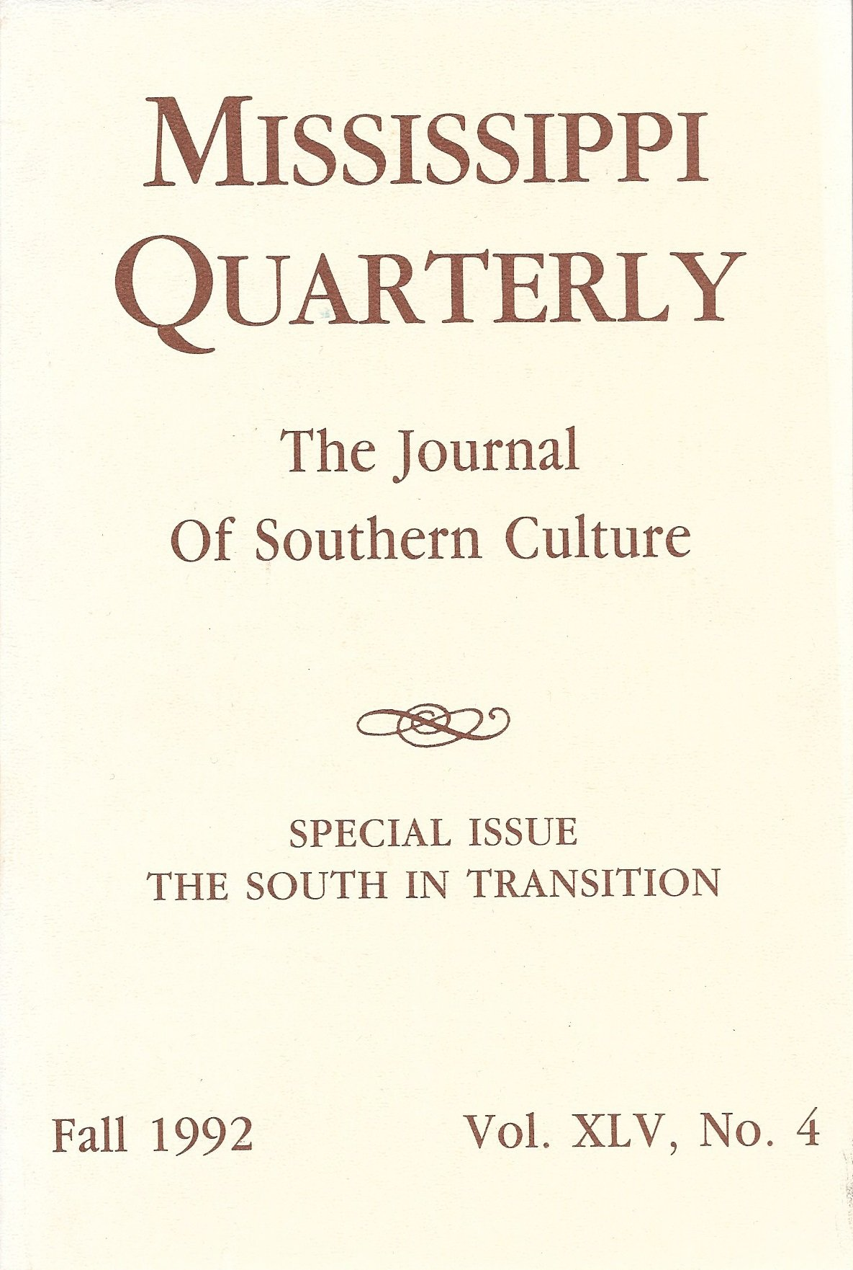
Breaking the Local Color Barrier: Kate Chopin’s Early and Lasting Reputation
as Seen through “A No-Account Creole”
Met with Dr. Hollings about possible venues
I read several article abstracts from five or six different journals.
Selected Mississippi Quarterly
They use "modified MLA style" formatting
Notes:
Read the full title
I met with Dr. Hollings about possible venues for this paper based on the subjects of Southern or Women's literature.
After we compiled a list, I read article abstracts from five or six different journals, including Arizona Quarterly, Nineteenth Century American Literature and Culture, and Tulsa Studies in Women's Literature.
I decided on Mississippi Quarterly based on the abstracts I read and their call for "original scholarship in the humanities and social sciences dealing with the US South broadly defined."
I also picked them partly because their "modified MLA style" formatting was easy to adapt to.

Slide 6
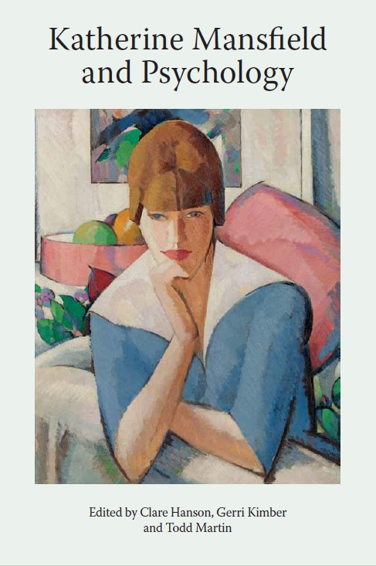
A Dawning Awareness: Katherine Mansfield’s Approach to Coming of Age in “The Garden Party” and “The Voyage”
Searched CFPs on the Univ of Pennsylvania website.
Located the Katherine Mansfield Society's Yearbook.
2022 is the centennial anniversary for the publication of The Garden Party and Other Stories
Since this collection is the focus of my paper, it was a perfect fit.
Notes:
Read the full title
Originally this was going to be a shorter conference length paper, so I began by searching CFPs (calls for papers) on the Univ of Pennsylvania website.
Through this serach, I found the Katherine Mansfield Society's Yearbook.
Since 2022 is the centennial anniversary for the publication of The Garden Party and Other Stories, that is their focus for current submissions.
Since this collection is the focus of my paper, it was a perfect fit, even though the length requirement was more than conference length.
So I converted the paper to a publication length piece as well.

Slide 7
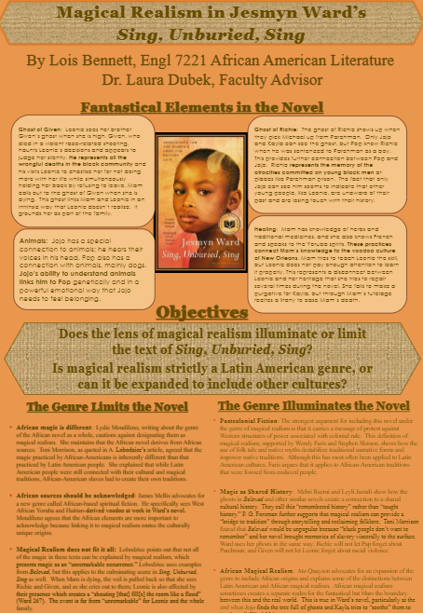
Magical Realism in Jesmyn Ward's Sing, Unburied, Sing
Originally a tri-fold poster for MTSU Scholar's Day 2020.
I had decided to create a Magical Realism mini-unit for my AP Literature class using Sing, Unburied, Sing and Beloved.
Venue: remediate the poster into a website for that unit.
Methods: adapt the material for a new audience and a new medium.
Notes:
Read the full title
This was originally a tri-fold poster for MTSU Scholar's Day 2020, but since Scholar's Day was converted to a digital format, I never did print the poster..
After researching this topic for Dr. Dubek's class, I decided to create a Magical Realism mini-unit for my AP Literature class using Sing, Unburied, Sing and Beloved.
I chose, after talking with Dr. Dubek, to re-mediate the poster into a website that I could use in my classroom to introduce my students to Magical Realism, help them select which novel to read, and share my research with them.
I had to adapt the material for a new audience and a new medium, as well as add material about Beloved.

Slide 8
The Revision Process
Professor Suggestions
Venue Guidelines: Style/Formatting Changes
Submission to the University Writing Center
Adding to the Word Count
Notes:
So then the actual Revision process began. I used each of the following to help me with my revisions:
Professor Suggestions – obtained through emails and zoom meetings
Style/Formatting changes – from the selected venues
The Writing Center suggestions – met via zoom with Percy and submitted both papers for document review, which was very helpful. It was great to get new eyes on the pieces after I had read them a dozen times.
Adding to the Word Count – which was the hardest part, and the part where I did not quite succeed. Both papers still fall almost 500 words shy of the publication guidelines.

Slide 9
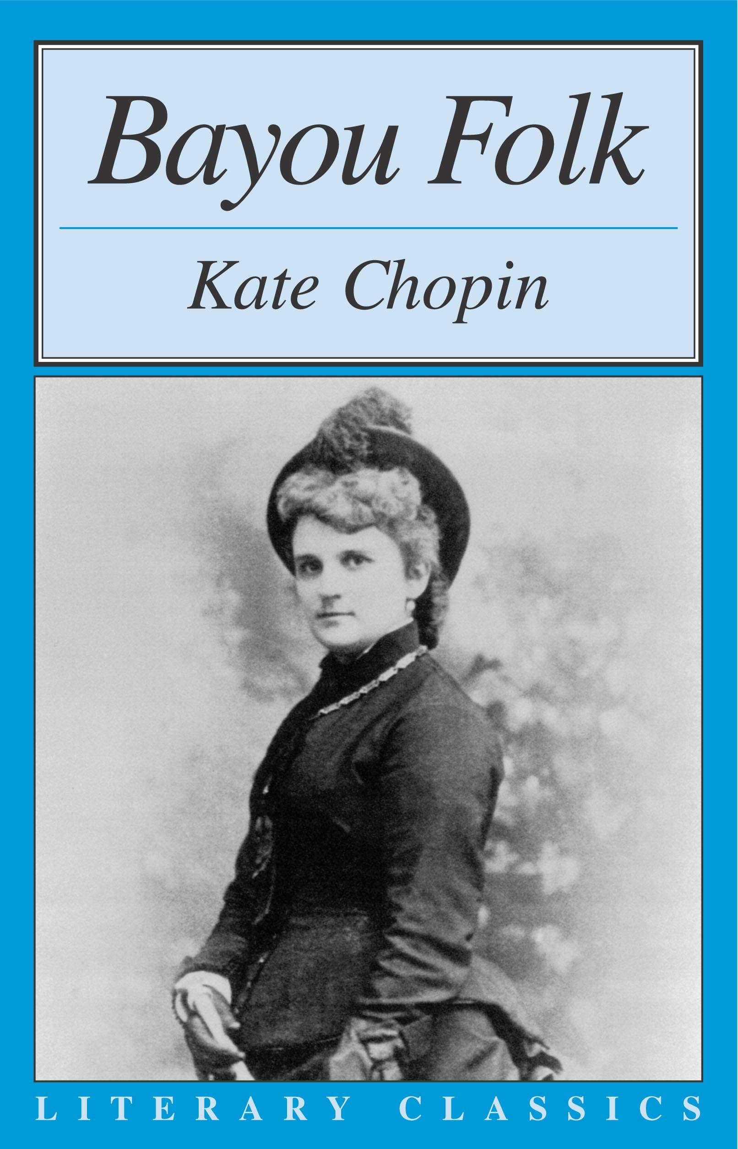
Revisions: Kate Chopin Paper
Full Title: Breaking the Local Color Barrier: Kate Chopin’s Early and Lasting Reputation as Seen through “A No-Account Creole”
Required the least amount of revision.
Clarified some vague or unclear sections, Fixed the formatting, Rephrased some sentences
Most challenging element: rereading the short story and some of the sources
Notes:
So now I would like to spend a short amount of time introducing you to the pieces I worked with. I know that most of you are not familiar with these specific works, so I will not be reading the whole paper to you, just giving an overview of my thesis and argument.
This paper required the least amount of revision.
I clarified some vague or unclear sections, fixed the formatting of the paper based on Dr. Hollings' suggestions, and rephrased some sentences. In this part, I benefitted from having been through another full year of grad school since I wrote it, so I had learned a lot about style.
The hardest thing about revising was also the time spent away, though. I had to reread the short story and some of the sources to refamiliarize myself with the material.
**Leave the PPT to show them the paper **

Slide 10
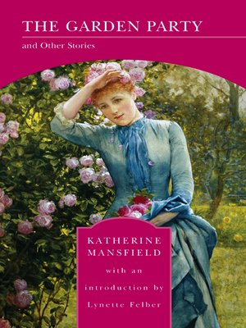
Revisions: Katherine Mansfield Paper
Full Title: A Dawning Awareness: Katherine Mansfield’s Approach to Coming of Age in “The Garden Party” and “The Voyage”
Easier to Revise because it was more recent.
Biggest challenge: finding the primary sources for the quotes from Mansfield.
Greatest revision: reworking the first two paragraphs
Revised to strengthen my own voice
Notes:
On to the next paper:
This paper was more familiar to me. Since I had just written it the previous semester, I did not have to return to as many of the sources.
The biggest challenge was trying to find the primary sources for the quotes from Mansfield. I tried going to books from the library, but Percy suggested searchable Google books and that was MUCH easier!
My greatest revision here was switching and reworking the first two paragraphs so that the biographical info about Mansfield did not distract from the thesis.
I also revised several paragraphs to strengthen my own critical voice over that of the sources.
** Go to the Paper**

Slide 11
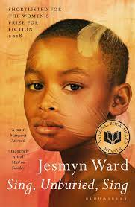
Revisions: Jesmyn Ward
Full Title: Magical Realism in Jesmyn Ward's Sing, Unburied, Sing
This is the project I am most proud of.
Most Challenging Element: adding the material about Beloved
Added sections that would appeal to my students and introduce them to the texts.
The Website: not completely new to me.
Notes:
Finally, This is the project I am most proud of because the revision looks very different from the original and I was able to use it in my classroom.
The most challenging part of this revision was adding the material about Beloved, but many of my sources had referenced Beloved anyway, so I did not have to add new sources, just refer back to my old ones.
I also had to add sections that would appeal to my students and introduce them to the texts. I was inspired to add music and video to the website because of how Dr. Dubek used them in her class and to create a multimodal piece.
I had used Wix.com for another project in grad school, so I did not have to learn a completely new system in creating the website.
** Go first to the poster to talk about the argument, and then to the website.**

Slide 12
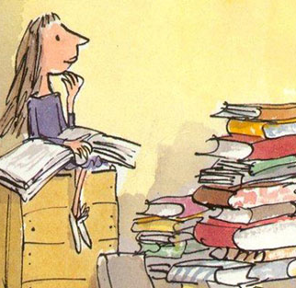
Final Step: Reflection
After completing your portfolio papers, you will need to write an essay about your revision experience, what you learned, and how you grew as a writer.
For myself, this process:
Challenged and rewarded.
Reflected my favorite pieces and works of literature.
Showed me the difference between a master's program, a doctoral program, and professional publication.
Made me interested a doctoral program and the focus that I would choose.
Most importantly, this portfolio process made me proud of the work I accomplished in grad school.
Notes:
Overall, The Portfolio Project was challenging and rewarding.
I enjoyed revisiting my favorite pieces and works of literature.
This process gave me a glimpse of the difference between a master's program, a doctoral program, and professional publication.
You might think I would be glad to be done with the program, but it actually made me want to jump right into a doctoral program and even gave me an idea of the focus that I would choose.
(It would be the 20th century modernists that we read in Dr. Kostkowska's class.)
Most importantly, this portfolio process made me proud of the work I accomplished in grad school.
**Ask if there are any questions and end the screen share.**

